Slide 1

Deloitte Consulting: Eliot’s Apparel
Team Revolution
February 9, 2018

Slide 2





Agenda
Overview of our presentation
Executive
Summary
Execution
Timeline
Risk
Analysis
Recommendations
Conclusion

Slide 3



Executive Summary | Issues and Solutions
Addressing Eliot’s retail challenges through innovative approaches in three main areas
Current Issues
Proposed Solutions
Expected Impact
Declining Sales Growth
Strategy
Mobile app for customer experience
Local design contest and fashion show
Increase in sales and a more engaging customer experience
Technology Integration Issues
Technology
Inventory system
Customer system
Employee portal
Increase sales and efficiency
High Costs, Low Efficiency
Human Resource Management
Employee talent optimization
Customer outreach programs
High quality employee benefits
More efficient labor force with community outreach programs

Slide 4

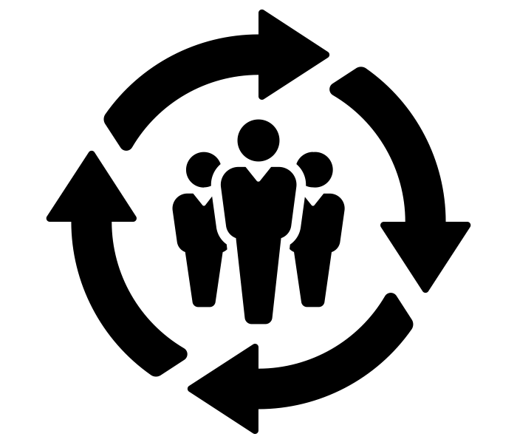
Strategy Recommendation Overview
Eliot’s Apparel can implement three core strategies to help increase current sales while also creating high community involvement
Low online sales is preventing Eliot’s from entering the new digital era
Creative and innovative features on mobile application
App would include loyalty rewards program to track consumer data
Create a more personal and engaging shopping experience
Mobile App Creation
Community Involvement Initiatives
Local stores lack differentiation from one another
Create a community vibe to bring in more locals
Community members submit own designs and community votes
Top votes get featured in a fashion show

Slide 5
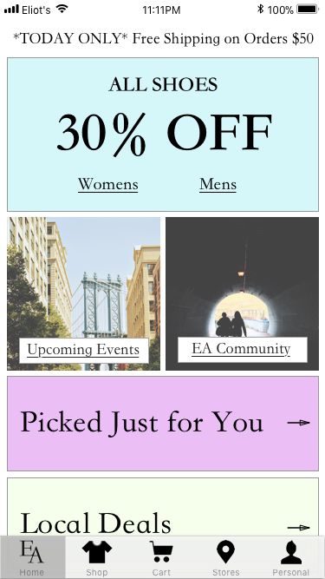
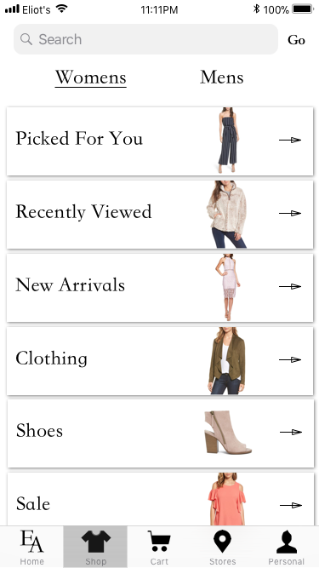
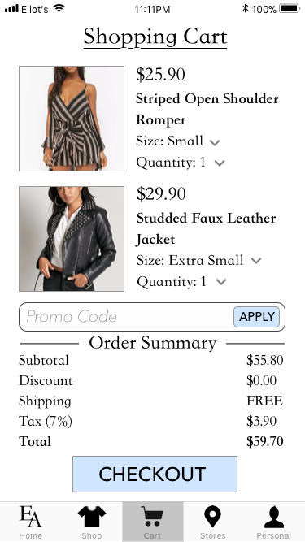
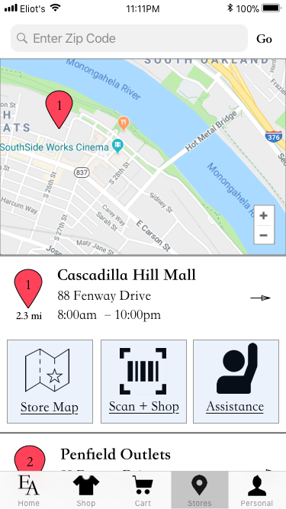
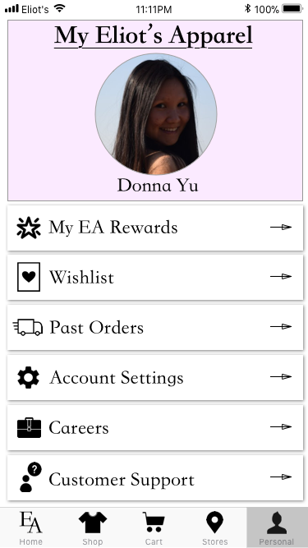
Strategy | Mobile Application Launch
To increase Eliot’s digital footprint, a mobile app can be used to offer innovative features to create a more personal customer experience
Mobile App Creation
Community Involvement Initiatives
Home
-Recommendation
of potential clothing
-Local promotions
-Upcoming events and competitions
-EA community
Shop
-Wide array of women’s and men’s clothing
-Recently viewed
-Recommendation section
Cart
-Items about to be purchased
-Check-out process
-Entering promo codes
Stores
-Location of close-by stores
-Blue print of all stores
-Scan barcode to see product details
-Call for assistance button if in a store
Account
-Customer profile
-Customer feedback
-Track orders
-Loyalty rewards card/barcode
*Clothing photos taken from Charlotte Russe, Nordstrom, or Forever 21

Slide 6
Strategy | Mobile Application Launch
To increase Eliot’s digital footprint, a mobile app can be used to offer innovative features to create a more personal customer experience
Mobile App Creation
Community Involvement Initiatives
Home
-Recommendation
of potential clothing
-Local promotions
-Upcoming events and competitions
-EA community
Shop
-Wide array of women’s and men’s clothing
-Recently viewed
-Recommendation section
Cart
-Items about to be purchased
-Check-out process
-Entering promo codes
Stores
-Location of close-by stores
-Blue print of all stores
-Scan barcode to see product details
-Call for assistance button if in a store
Account
-Customer profile
-Customer feedback
-Track orders
-Loyalty rewards card/barcode
*Clothing photos taken from Charlotte Russe, Nordstrom, or Forever 21

Slide 7
Strategy | Mobile Application Launch
To increase Eliot’s digital footprint, a mobile app can be used to offer innovative features to create a more personal customer experience
Mobile App Creation
Community Involvement Initiatives
Home
-Recommendation
of potential clothing
-Local promotions
-Upcoming events and competitions
-EA community
Shop
-Wide array of women’s and men’s clothing
-Recently viewed
-Recommendation section
Cart
-Items about to be purchased
-Check-out process
-Entering promo codes
Stores
-Location of close-by stores
-Blue print of all stores
-Scan barcode to see product details
-Call for assistance button if in a store
Account
-Customer profile
-Customer feedback
-Track orders
-Loyalty rewards card/barcode
*Clothing photos taken from Charlotte Russe, Nordstrom, or Forever 21

Slide 8
Strategy | Mobile Application Launch
To increase Eliot’s digital footprint, a mobile app can be used to offer innovative features to create a more personal customer experience
Mobile App Creation
Community Involvement Initiatives
Home
-Recommendation
of potential clothing
-Local promotions
-Upcoming events and competitions
-EA community
Shop
-Wide array of women’s and men’s clothing
-Recently viewed
-Recommendation section
Cart
-Items about to be purchased
-Check-out process
-Entering promo codes
Stores
-Location of close-by stores
-Blue print of all stores
-Scan barcode to see product details
-Call for assistance button if in a store
Account
-Customer profile
-Customer feedback
-Track orders
-Loyalty rewards card/barcode
*Clothing photos taken from Charlotte Russe, Nordstrom, or Forever 21

Slide 9
Strategy | Mobile Application Launch
To increase Eliot’s digital footprint, a mobile app can be used to offer innovative features to create a more personal customer experience
Mobile App Creation
Community Involvement Initiatives
Home
-Recommendation
of potential clothing
-Local promotions
-Upcoming events and competitions
-EA community
Shop
-Wide array of women’s and men’s clothing
-Recently viewed
-Recommendation section
Cart
-Items about to be purchased
-Check-out process
-Entering promo codes
Stores
-Location of close-by stores
-Blue print of all stores
-Scan barcode to see product details
-Call for assistance button if in a store
Account
-Customer profile
-Customer feedback
-Track orders
-Loyalty rewards card/barcode
*Clothing photos taken from Charlotte Russe, Nordstrom, or Forever 21

Slide 10
Strategy | Mobile Application Launch
To increase Eliot’s digital footprint, a mobile app can be used to offer innovative features to create a more personal customer experience
Mobile App Creation
Community Involvement Initiatives
Home
-Recommendation
of potential clothing
-Local promotions
-Upcoming events and competitions
-EA community
Shop
-Wide array of women’s and men’s clothing
-Recently viewed
-Recommendation section
Cart
-Items about to be purchased
-Check-out process
-Entering promo codes
Stores
-Location of close-by stores
-Blue print of all stores
-Scan barcode to see product details
-Call for assistance button if in a store
Account
-Customer profile
-Customer feedback
-Track orders
-Loyalty rewards card/barcode
*Clothing photos taken from Charlotte Russe, Nordstrom, or Forever 21

Slide 11
Strategy | Mobile Application Launch
To increase Eliot’s digital footprint, a mobile app can be used to offer innovative features to create a more personal customer experience
Mobile App Creation
Community Involvement Initiatives
Home
-Recommendation
of potential clothing
-Local promotions
-Upcoming events and competitions
-EA community
Shop
-Wide array of women’s and men’s clothing
-Recently viewed
-Recommendation section
Cart
-Items about to be purchased
-Check-out process
-Entering promo codes
Stores
-Location of close-by stores
-Blue print of all stores
-Scan barcode to see product details
-Call for assistance button if in a store
Account
-Customer profile
-Customer feedback
-Track orders
-Loyalty rewards card/barcode
*Clothing photos taken from Charlotte Russe, Nordstrom, or Forever 21

Slide 12


Strategy | Design Contest and Fashion Show
To initiate community involvement, Eliot’s can have an annual design contest where top votes can be featured in the local fashion show
Design Contest
Local Fashion Show
Design Contest
Local Fashion Show
Mobile App Creation
Overview: The designs with the highest votes will be featured in a local fashion show.
Logistics: The nominees can model their own outfit or pick someone to model for them. The winner will get their design featured in the store.
Goal: Also feature other Eliot’s apparel in the show. Shows community talent.
Predicted Outcome: A new selling opportunity for Eliot’s and also increased revenue from show ticket sales.
Locals submit original pieces to any of the clothing categories (submit online or in stores)
Anyone with a free EA rewards account can vote
Example cities to launch: New York City, Los Angeles, Las Vegas, Chicago, Miami, Nashville
Benefits local community, fashion designers, and Eliot’s Apparel
Expand to more cities if successful
Goal
Improved community engagement and participation
Increased EA rewards registrants
Designs with the highest votes will be featured in a local fashion show
Cut cost by letting designers model in own outfit (or have a friend do it)
Winner can have design manufactured and sold in stores
Sales revenue from fashion show tickets
Feature additional Eliot’s apparel in show
Goal
Bring together community to support local talent
New marketing opportunity for Eliot’s
Community Involvement Initiatives

Slide 13







Technology | Information Systems
Eliot's will implement three information systems to help companies better understand the local communities and customer demand
Analyze individual customers preferences
Increase customer brand loyalty
Customer System
Information Systems
System Implementation
Inventory System
Employee System
Increase traceability of inventory
Cut back on unsold inventory
Increase employee efficiency
Record employee performance

Slide 14








Technology | System Implementation
Implementation of new software to improve customer relationships, manage employees, and streamline inventory
Time
CRM
ERP
RFID
Information Systems
Customer Relationship Management
Enterprise Resources Planning
Radio Frequency Identification
System Implementation
Cost: ~ $4000
Implementation: 6 months – 1 year
Customer-oriented
Cost: $150K - $1 million
Implementation: 1 - 3 years
Management-oriented
Cost: $0.5 – $1 per tag
Implementation:
~4 years
Inventory-oriented
A data-driven company

Slide 15


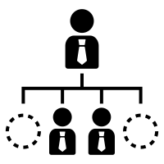
Human Resource Management | Labor Efficiency
Methods to increase employee performance and efficiency by implementing new systems and software
Oracle HCM
App Utilization
Workday
Labor Efficiency
Allows for greater collaboration between employees
Greater insight into the inner workings of the store
Allows employees to check customers out using their smart phones
Cuts back on the number of dedicated cashiers needed
Highlight the strengths of all employees and places them within the restructure accordingly
Greater efficiency due to better alignment between an workers skills and their job
Minimizing Turnover Rate

Slide 16




Human Resource Management | Employee Engagement
Increase quality of employee benefits to increase employee satisfaction and lead to a lower turnover rate
Labor Efficiency
Greater responsibility given to employees
Personal support and development programs
Minimizing Turnover Rate
Result: Greater employee satisfaction and retention
Increase community involvement through service projects

Slide 17
Execution Timeline
Five-year breakdown of recommendations from the three areas
Evaluate design contest and fashion show performance
Launch royalty rewards card
Community outreach
Implement ERP
Set-up self-checkout registers with RFID
Employee role restructuring
Fashion show
2018
2019
2020
2021
2022
Implement CRM
Design contest
Launch
design contest & fashion show in more cities
Implement RFID
Launch mobile
app
Invest in interactive fitting rooms
Employee support
Create sustainable goals
Social impact project

Slide 18
Risk Analysis
Evaluation of the potential risks associated with the recommendations
Self-assessment questions
Risks
Increased responsibility placed on employees leading to higher stress
The current demographics of Eliot’s Apparel is unknown
Increased competition from online retailers
How is innovation imbedded in the new business infrastructure?
How do you evaluate changes in factors such as integration of information technology, implementation of new business strategies, and changing workforce demographics?
Are we maintaining the company’s core values while also trying to maximize profits and reduce risks?
Mitigation
Increased training programs and employee support
Tech savvy customers have the benefit of the app, while others will benefit from community outreach
By optimizing the shopping experience, we hope that people find the value of coming into the store

Slide 19



Conclusion
Synergies of all the recommendations
Strategy
Technology
Human Resources
“Become a national brand with a local feel”

Slide 20
Questions and Comments?
Thank you!

Slide 21
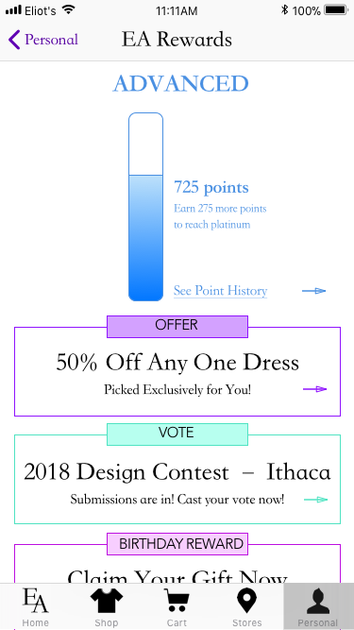
Appendix: Loyalty Rewards Program
Introduction of a loyalty rewards program to track customer spending and increase customer retention and satisfaction
Join the Rewards Club
EA Rewards is the one-stop-shop to rack up stars and cash out on some amazing rewards. It’s completely free, easy to sign up for, qualifies you for different events and competitions, and has zero fees ($1 spent = 1 point).
THE PERKS
Basic Advanced Platinum
(0 - 150) (151 – 1000) (1000+)
25% off first purchase
Vote in competitions
Personalized discounts and offers
Birthday gift
Flash fashion mentor
Exclusive access to annual club sale
Carefully crafted reward packages (bi-annual)

Slide 22















Appendix: Competitor Analysis
Comparing Eliot’s Apparel to other competitors in the retail industry
High cost
Negative
Shopping Experience
Positive
Shopping Experience
E
A
Low cost

Slide 23
Appendix: Financial Analysis
Projected financial breakdown from cost of implementation and revenue increase
 | 2016 | 2017 | 2018 | 2019 | 2020 | 2021 | 2022
Revenue | $3.900 | $3.720 | $3.820000 | $3.910000 | $4.000000 | $4.108000 | $4.186000
COGS* | $2.400 | $2.200 | $2.120000 | $2.040000 | $2.020000 | $2.030000 | $2.050000
Gross Margin* | $1.500 | $1.520 | $1.700000 | $1.870000 | $1.980000 | $2.078000 | $2.136000
Operating Costs*
App development and maintenance | - | - | $0.000200 | $0.000050 | $0.000050 | $0.000050 | $0.000050
Loyalty Rewards Discount | - | - | $0.000800 | $0.000500 | $0.000400 | $0.000380 | $0.000350
Fashion Show and Design Contest |  |  | $0.001000 | $0.001200 | $0.001400 | $0.001600 | $0.001600
CRM | - | - | $0.000001 | $0.000001 | $0.000001 | $0.000001 | $0.000001
ERP | - | - | - | - | $0.000800 | $0.000100 | $0.000100
RFID | - | - | - | - | - | $0.000400 | $0.000450
Future Technologies | - | - | - | - | - | - | $0.001750
Net Income* | $1.500 | $1.520 | $1.697999 | $1.868249 | $1.977349 | $2.075469 | $2.131699
*Due to insufficient data, these numbers were estimated based on our market research on competitors
Assumptions:
Sales revenue increases by ~2% annually after 2018
Recommendations don’t require large capital investments
Emphasis on strong customer focus could potentially drive sales
Initial capital raised from loyalty rewards program gains
Positive ROI for fashion show hosting and design contest

Slide 24
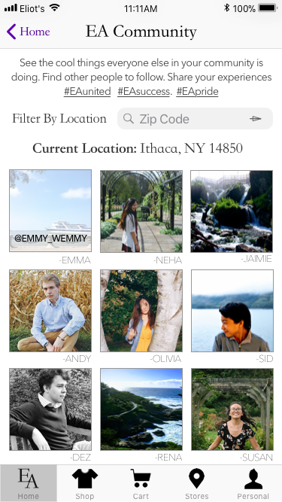
Appendix: Eliot’s Community
Overview of the Eliot’s Apparel community section of the mobile application designed to increase community engagement
Local photos picked to be featured
Explore what other individuals in the area are doing
Sense of unity in the different local store areas
Discover the differences by viewing other locations
Different hashtags to sort posts
#EAunited
#EAsuccess
#EApride

Slide 25



Appendix: Future Development of Technology
These are potential ideas that can be implemented in 4-5 years once Eliot’s is in a stable financial condition
RFID: Each item will have its own identification code. When customers want to find an item, they can scan the RFID codes and easily access the item.
Interactive Fitting Room: Customers can change the settings of fitting room to see find more items and receive better service.
Self-checkout registers: Customers can self-check out their items with the use of the RFID technology.

Slide 26
Appendix: Customer Relationship Management (CRM)
In-depth overview of CRM system recommended in the technology section
Sales
Marketing
Customer Service
7P analysis in CRM
Profiling: Customer segments, risks, habits, preferences
Persistency: How long does the customer stay with the products
Profitability: Company receive different margin, total revenue and gross profit from different customers
Performance: Understand the geolocation, categories and channels of buying products.
Prospecting: Developing new methods to attract new customers
Product: Design of product, sales bundle, supply chain etc.
Promotion: Management of promotion, advertisement and events
Advantages: 1: Through CRM, you can sort out the data of successful salesman and integrate the process of how they manage customers into the system.
Advantages: 2: CRM can records all the sales history and contact history with customers. When new employees take the position, they will fit into the system quickly.
Advantages: 3: CRM can help company rank customers’ brand loyalty and stickiness. It helps the company allocate the limited resources and increase sales.
W Chang, J.E Park, S. Chaiy, How does CRM technology transform into organizational performance? A mediating role of marketing capability, Journal of Business Research, Volume 63, Issue 8, 2010, Pages 849-855

Slide 27


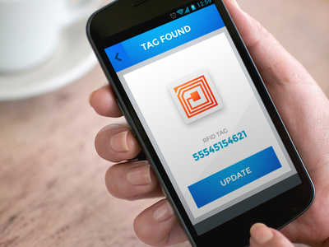
Appendix: Radio Frequency Identification
RDIF can be implemented in year 3 to prepare for more innovative technologies (self check-out)
EPC
Assign unique codes for each product
Print the bar code and stick it with the assigned item
Customers find the item and scan it
Advantages: :
It can easily track customers’ interaction with the products.
It can help customers self-checkout at the register.
It can check the availability of products of each store, which can better arrange the inventories and reduce the products which are hard to sell.
It can help customers find the location of items in an store quickly.
Disadvantages: :
The technology has a high sunk cost to be implemented.
The technology has not be widely used in the industry.
This technology has the risk of violating the privacy and harming the data security of customers.
This technology needs technicians and professions to maintain.
RFID (Radio Frequency Identification): Principles and Applications by Stephen A. Weis

Slide 28
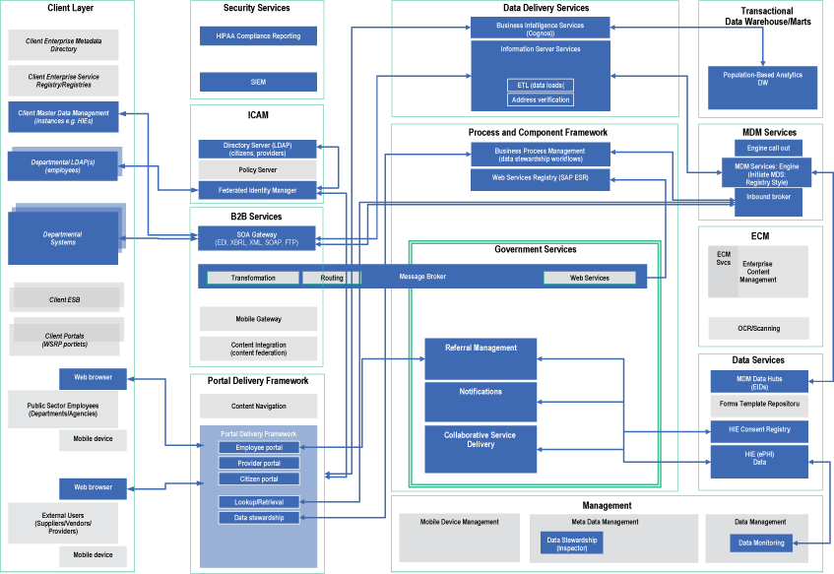
Appendix: Enterprise Resource Planning (ERP)
Layout of the ERP framework and the benefits it can bring to Eliot’s
https://www.ibm.com/developerworks/rational/library/macro-pattern-public-sector-systems-architecture/index.html

Slide 29
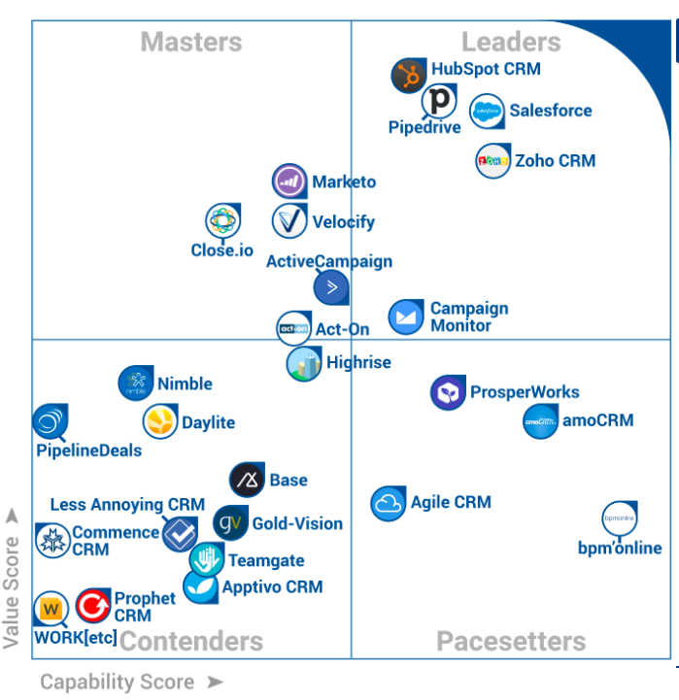
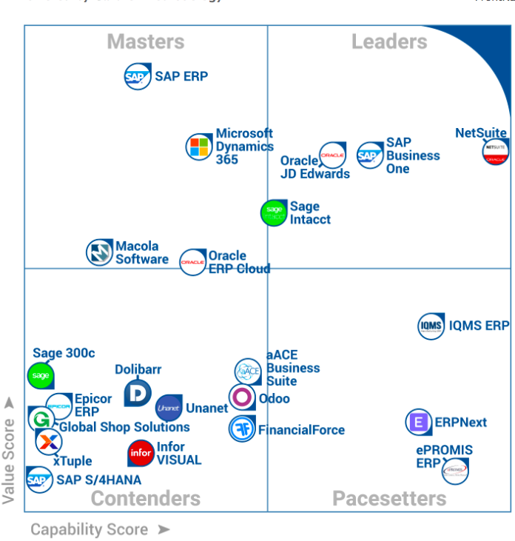
Appendix: Ranking of Popular CRM and ERP
Comparing CRM and ERP to competitors in the field
FrontRunners® for Customer Relationship Management, August 2017
Powered by Gartner Methodology

